Slide 1
SSW-810: Software Engineering Tools and Techniques
More Python Fundamentals:
Classes, Exceptions
Prof. Jim Rowland
Software Engineering
School of Systems and Enterprises

Slide 2
Acknowledgements
This lecture includes material from:
“How to Think Like a Computer Scientist: Learning with Python 3 (RLE)”, Peter Wentworth, Jeffrey Elkner, Allen B. Downey, and Chris Meyers,
http://openbookproject.net/thinkcs/python/english3e/
“Introducing Python”, Bill Lubanovic, ISBN-13: 978-1449359362
http://proquest.safaribooksonline.com/book/programming/python/9781449361167
“Python 3 Object-oriented Programming, Second Edition”, Dusty Philips, http://ezproxy.stevens.edu:2155/book/programming/python/9781784398781

Slide 3

Today’s topics
Objects, classes, and instances
Encapsulation
Class attributes and methods
Single inheritance
CRC Cards
Exceptions
Catching exceptions
Raising exceptions
Defining custom exceptions

Slide 4
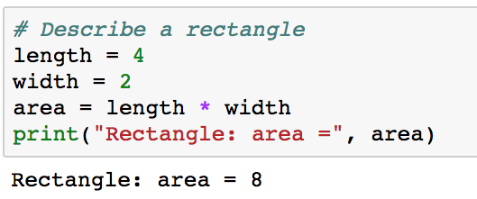
What problem are we trying to solve?
Writing, testing, reading, and maintaining code is hard
What can we do to help?
Consider a simple example of a rectangle
That’s pretty simple… What’s the problem?

Slide 5
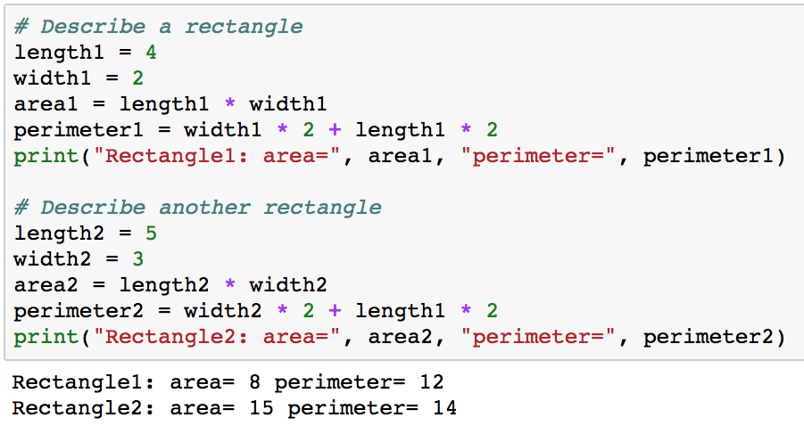

What could possibly go wrong?
That code works great for one instance of rectangle
How does that scale to many rectangles?
What if we add or change features?
Added a new feature (perimeter) to rectangles, but now I need to change code in two places
Oops! Copy/Paste can go wrong
Wait! That should be 16...

Slide 6

Objects provide encapsulation
Encapsulation bundles data and the operations that work on that data in a single place
Define a “box” that contains everything we need to know about rectangles and reuse that definition many times
Include both data and functions
Now it’s easier to create and manipulate many Rectangles
Easier to isolate Rectangles
Easier to test, enhance, maintain, and reuse Rectangles
Everything in one place
API
Rectangle:
length
width
area()
perimeter()

Slide 7
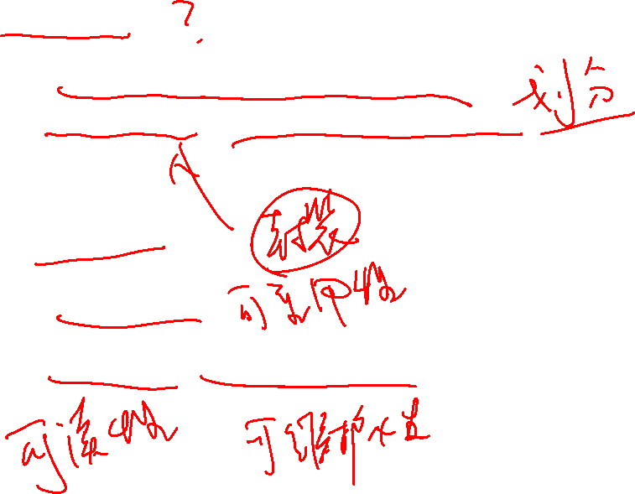
Why objects?
Objects help to design and organize code
Better encapsulation/compartmentalization
Break big problems into small, more manageable chunks
Reduce duplicate code
Increase reusability
Improve readability, maintainability

Slide 8
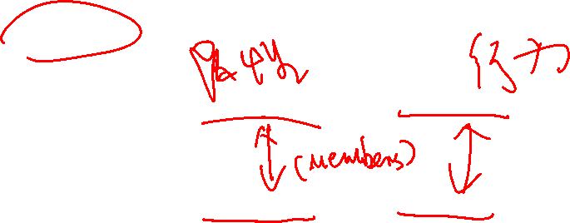
Classes represent objects
Objects have properties and behaviors
Define classes to represent objects
Classes have attributes and methods
Properties are represented as attributes with values
Methods are represented as functions that perform some behavior for the object
Object
Properties
Behaviors
Class
Attributes
Methods

Slide 9
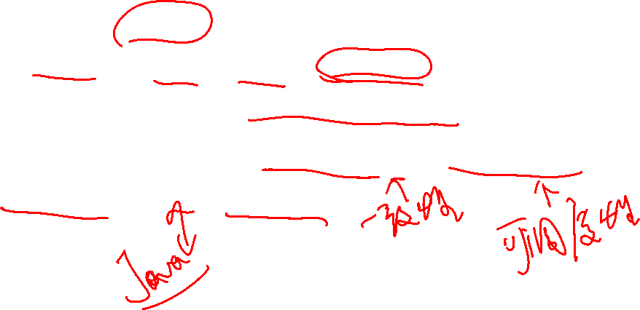
Object Oriented Programming
Python uses classes to represent objects
Numbers, functions, classes, exceptions, …
Classes allows defining compound data types
Encapsulation enhances consistency and predictability
Everything in Python is an object
Class
Attributes
Methods

Slide 10
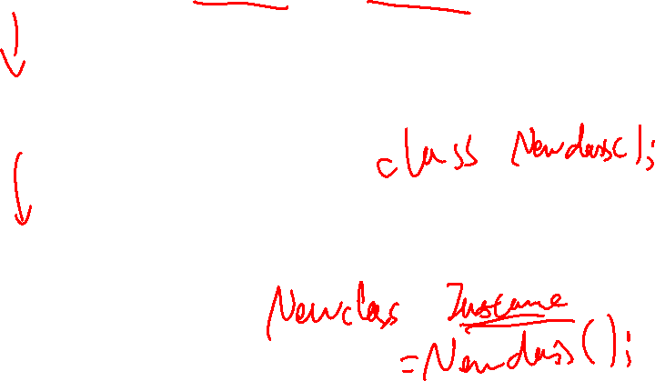
Objects, Classes, and Instances
Object
A physical or logical entity
Class
The Python representation of an object
Instance
An instance in memory of a class

Slide 11
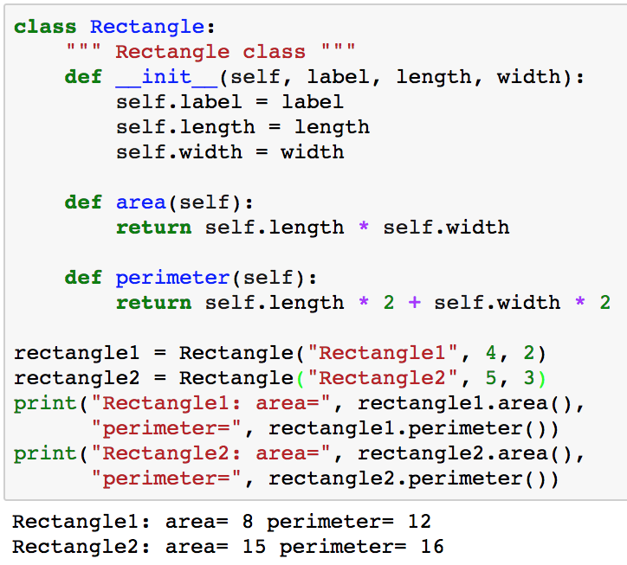
class Rectangle
class names use CamelCase
Initialize the attributes in a new instance of class Rectangle
Methods are functions inside the class definition
Create instances of class Rectangle
instance.method(args) invokes method(self, args) on instance. Python adds the ‘self’ argument automatically.

Slide 12

Within a class definition…
self
Refers to the memory allocated for that instance of the class
First parameter in every method, including __init__(self)
Instance attributes
Data members that are included in every instance of the class
Defined in __init__(self)
Accessed as self.attribute
Methods
Functions defined for this class that may access any attribute using instance.method(args)
Each class instance has its own distinct copy of the instance attributes
Python passes instance as self

Slide 13
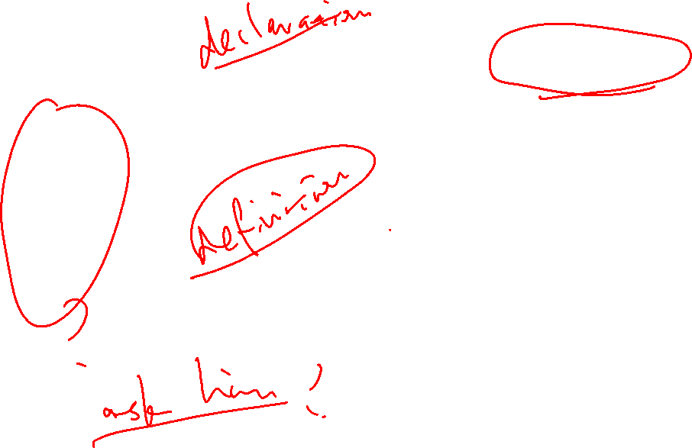
Create a new instance of class Rectangle
rectangle1 = Rectangle(’Rectangle1’, 4, 2)
Create a new instance of class Rectangle
rectangle1
Python allocates space for a new instance of class Rectangle
Rectangle.__init__(rectangle1, ‘Rectangle1’, 4, 2)
Python calls Rectangle.__init__() with the new instance and arguments
rectangle1
label = ‘Rectangle1’
length = 4
width = 2
The new instance is initialized by __init__() and the attributes are defined and initialized

Slide 14
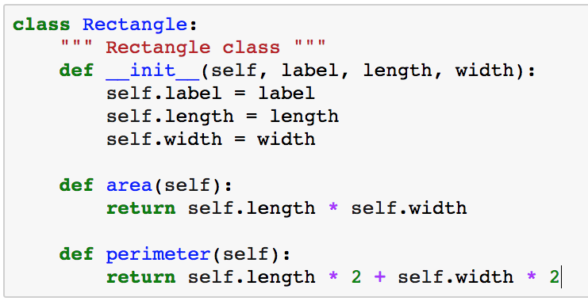
Inside class Rectangle: __init__(self, …)
class names use CamelCase
Docstring displayed by help(Rectangle)
First parameter must be ‘self’. Specify other parameters as needed
self.attribute defines a new instance attribute which is distinct to this instance of the class
__init__() may have any logic, not just defining and initializing instance attributes

Slide 15
Inside class Rectangle: methods
First parameter must be ‘self’. Specify other parameters as needed
Methods may use any instance attributes along with other arbitrary logic

Slide 16
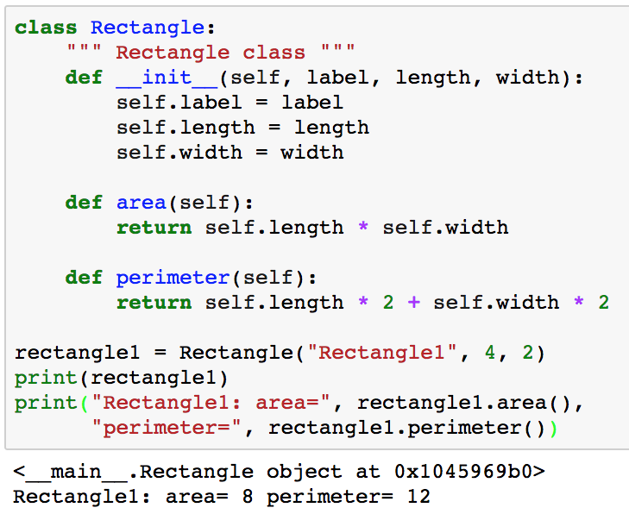
Printing class instances
Printing a class instance prints the context, type, and the memory address
How to encapsulate the information about this instance?

Slide 17
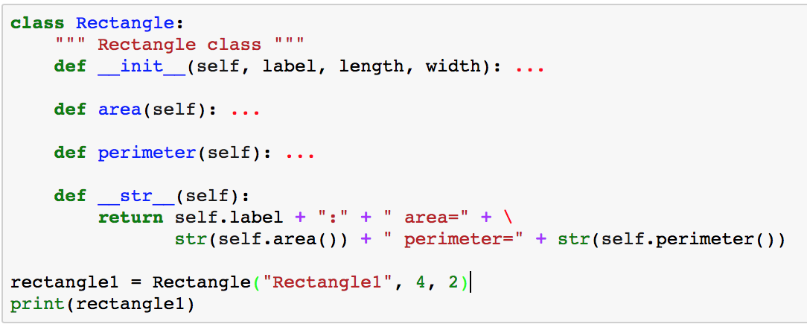

Printing class instances
__str__(self) is a magic method that returns a string to describe an instance of a class
Encapsulate relevant information about this instance of class Rectangle inside the class definition
string₁ + string₂ concatenates string₁ and string₂

Slide 18
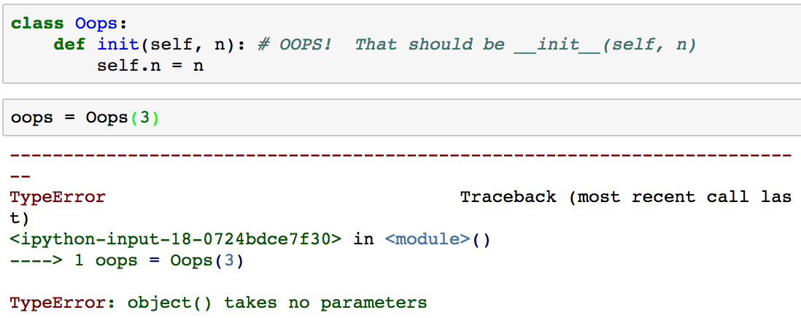
Huh??? What could possibly go wrong?
Huh? Init(self, n) expects an argument
Check spelling of __init__(self)

Slide 19


Attributes can be added anytime
By convention, instance attributes are added in __init__()
Unlike C++ and Java, Python allows adding attributes to an instance of a class at any time
Including an attribute in __init__(self) adds the attribute to all instances
C++ and Java require all attributes to be included in the class definition
This might be a great feature or a unexpected (unpleasant) surprise

Slide 20
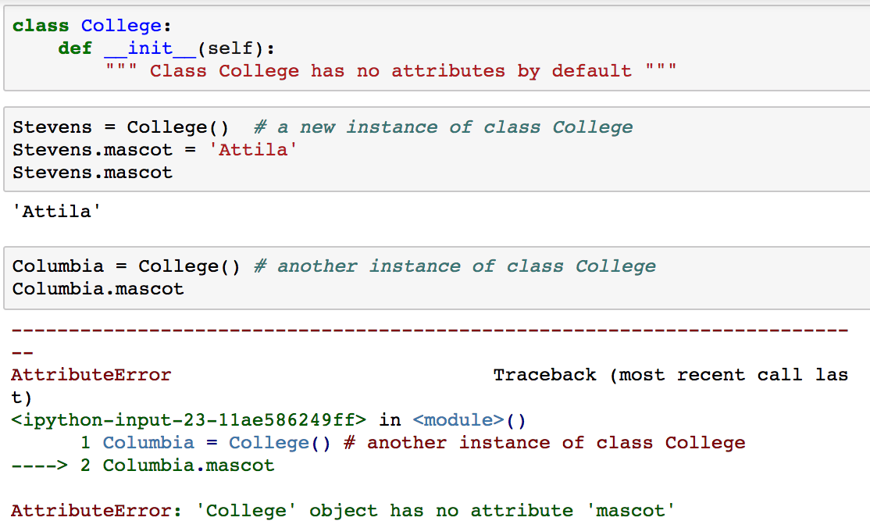
Attributes can be added anytime
The Stevens instance of College now has attribute ‘mascot’ that was not defined in __init__(self)
Only the Stevens instance of college has attribute ‘mascot’

Slide 21
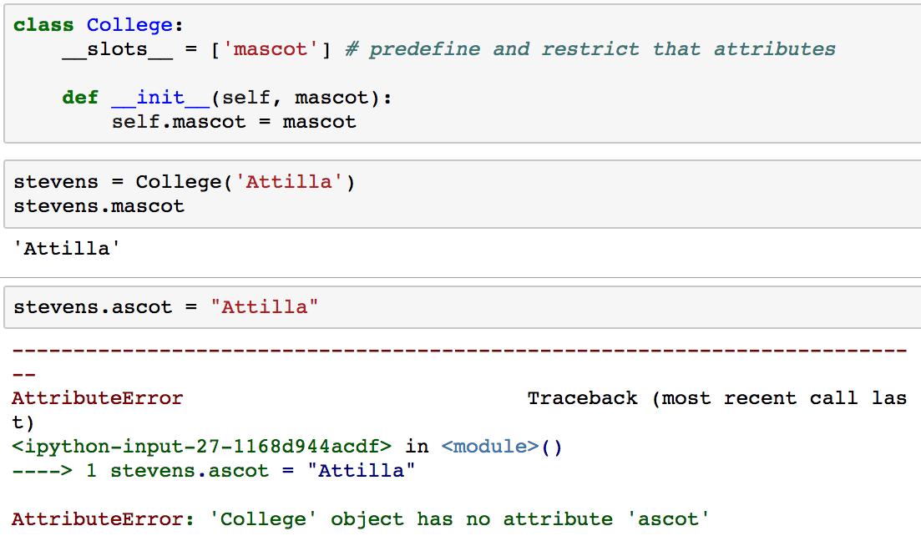

Avoid accidental attributes
Every class includes a __slots__ attribute that allows you to restrict accidental attributes
Only attributes included in __slots__ will be allowed
__slots__ is a class attribute that is shared across all instances of class College
Oops! ’mascot’, not ‘ascot’

Slide 22
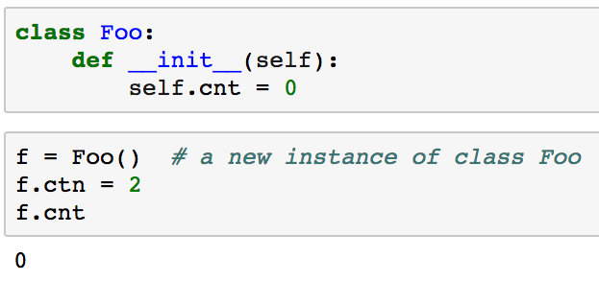
Attributes guidelines
Initialize all class instance attributes in __init__(self)
This insures they are defined and initialized
Helps readers to understand which attributes are available
Beware of typos that don’t generate warnings
Specify __slots__ to avoid surprises
No __slots__ defined so attributes can be added anywhere
Oops!!I I meant to type ‘cnt’ but my typo added a new ‘ctn’ attribute available ONLY to the f instance of class Foo

Slide 23
Inheritance
Inheritance provides a convenient mechanism to represent relationships between objects with an IS-A relationship
Shape
Rectangle
Square
Oval
Circle

Slide 24

Single Inheritance
Inheritance defines a new class
The new class inherits all of the methods and class attributes
Allows specialization to add new attributes and methods
Rectangle
Super class
IS-A
Square
Subclass

Slide 25
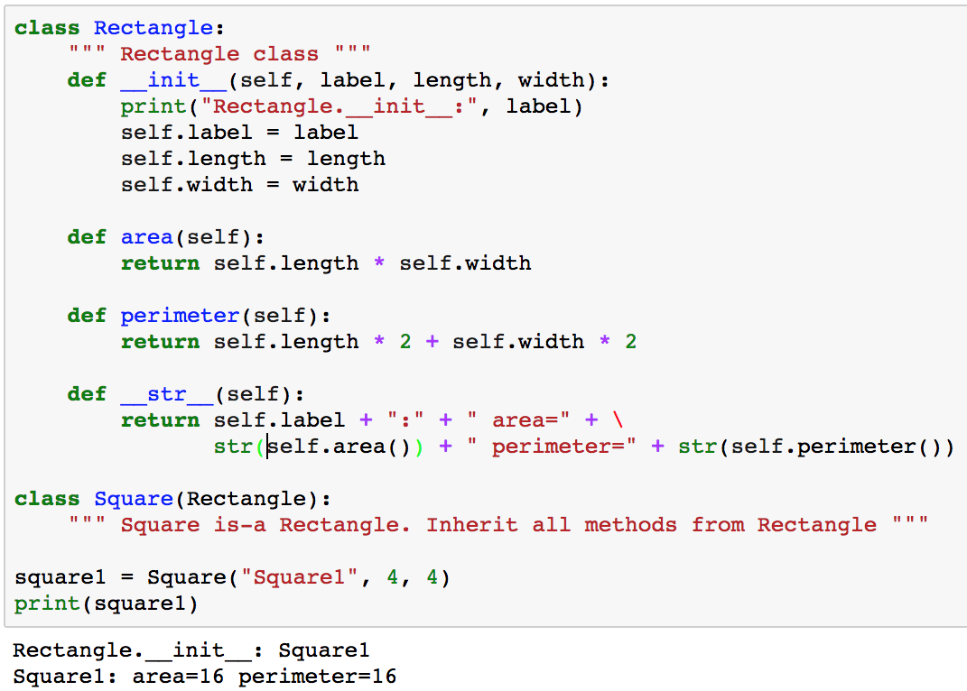
class Square
Square inherits all methods from Rectangle, including __init__()
Wait! That’s not convenient… Want a new Square.__init__(self, label, len)
Creating a Square calls Rectangle:__init()

Slide 26
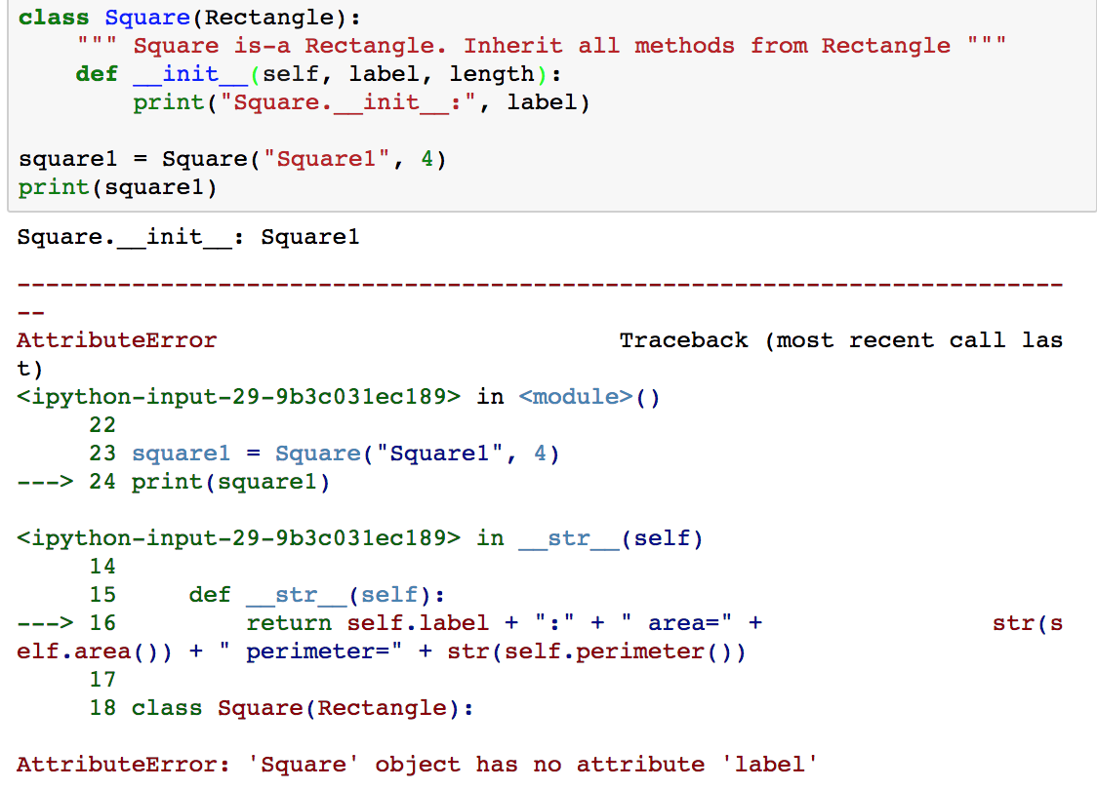
class Square
Redefine Square.__init__()
Square inherited __init__(self, label, length, width) from Rectangle but we redefined __init__(self, label, length).
Oops! Redefining __init__() lost all of the instance attributes defined in Rectangle.__init__()
We could include all of the instance attributes from the superclass in __init__() but what if the definition of Rectangle changes?

Slide 27


Overriding __init__()
Any attribute or method from the superclass can be overridden in the subclass, including __init__()
Overriding a method replaces the definition of the method in the subclass
Careful! If you override __init__() then the superclass’s __init__() is NOT called (unless you call it explicitly)
C++ automatically invokes the parent’s constructor
__init__() typically defines the instance attributes so those instance attributes won’t be included in the subclass
Instance attributes are not inherited because they are not part of the class definition. They are created by __init__()

Slide 28
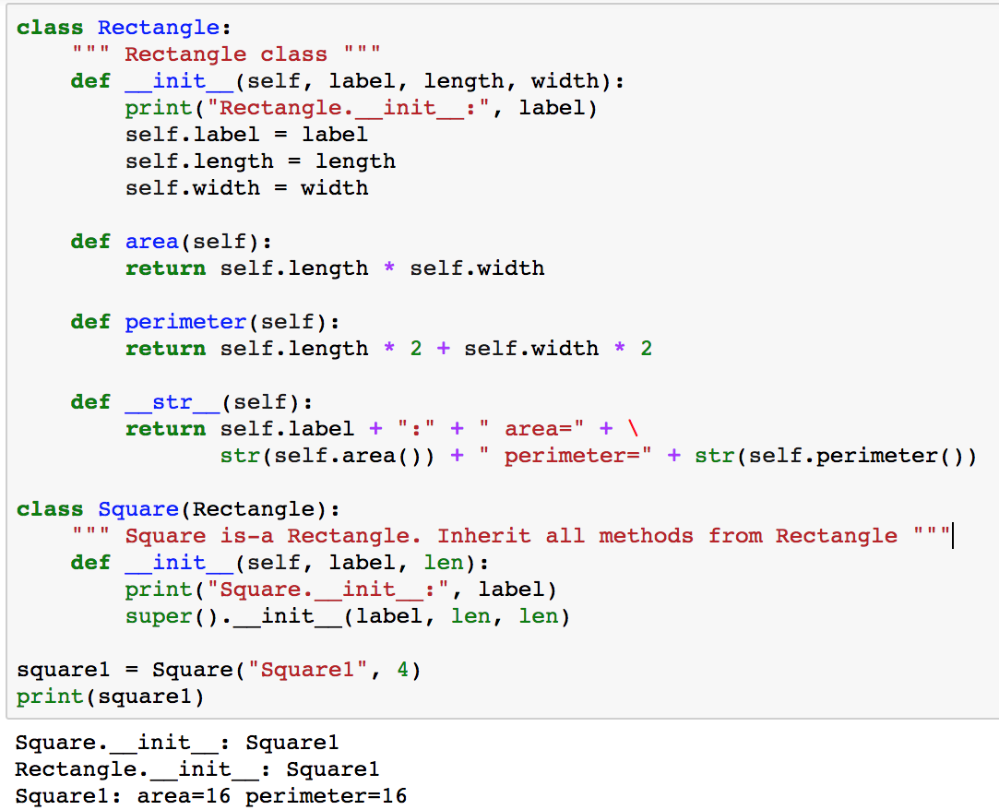
class Square: redefine __init__()
Delegate initializing the superclass to the subclass. Don’t replicate the code in the subclass
Call super().__init__() from __init__() to initialize superclass instance attributes
Rectangle.__init__() is invoked by the call to super().__init__()
All class and instance attributes from Rectangle are available in Square after calling super().__init__()

Slide 29
Single Inheritance: Employee
Class Employee:
Attributes
name
title
Methods
__init__()
work()
__str__()
Class Manager:
Attributes
name
title
team_size
Methods
__init__()
work()
__str__()
Class Manager inherits all of class Employee’s methods, including __init__().
Add new attributes or replace method behavior
Manager is-a Employee
Managers have an additional attribute: team_size
Managers work() method is different from Employee’s
Managers have the same __str__() as Employees

Slide 30
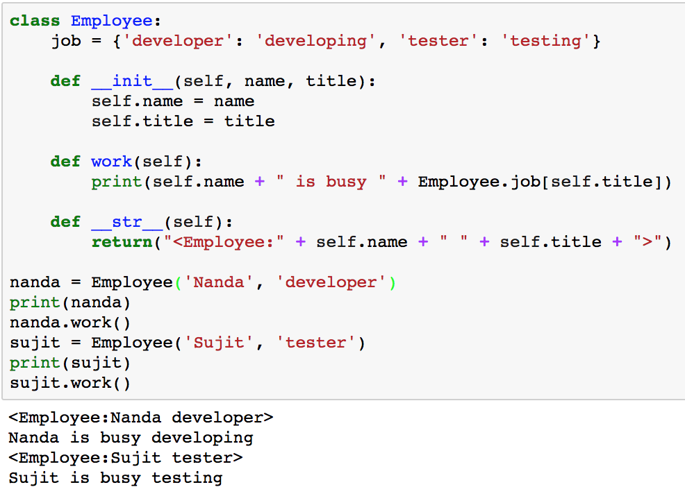
class Employee
Class attributes are defined in the class and are shared across all instances of the class

Slide 31
Single Inheritance
Employee
Super class
IS-A
Manager
Subclass

Slide 32
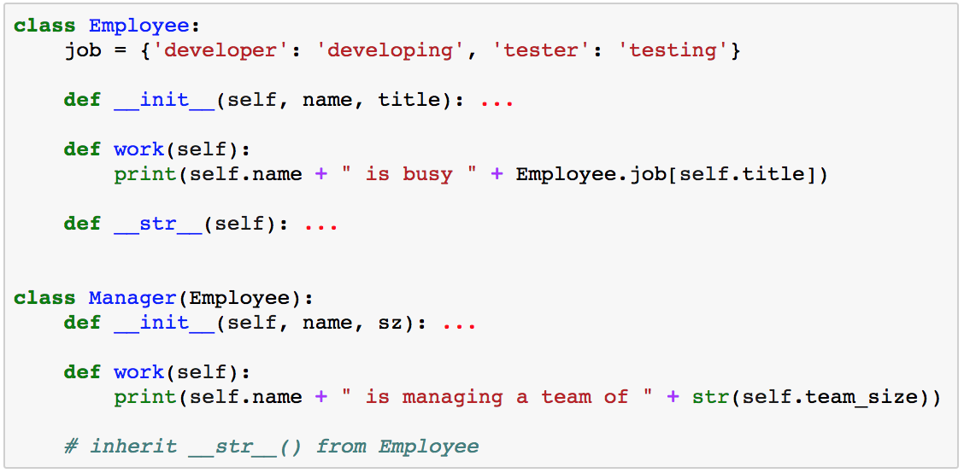

Overriding methods
A subclass may override a method of the super class
Python chooses the appropriate method to invoke at run time based upon the type of the instance
work() is defined in both Employee and Manager
Manager.work() overrides Employee.work() in instances of Manager

Slide 33
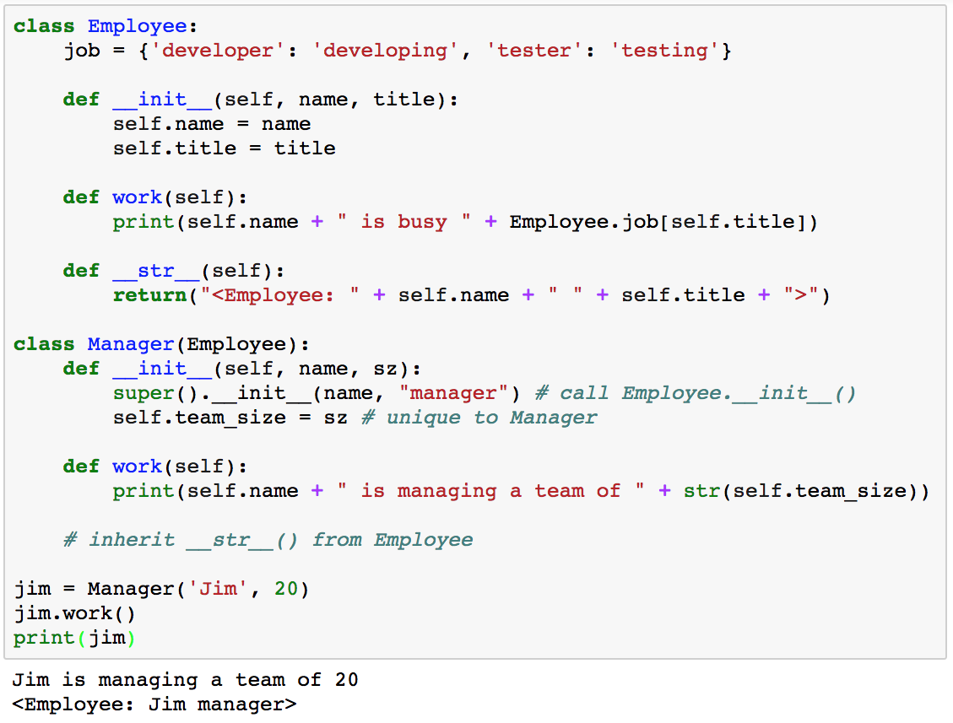
class Manager
Manager is-a Employee
Manager inherits all methods and class attributes from Employee, including __init__() which initializes instance attributes. We can also add new attributes and methods to the subclass.

Slide 34
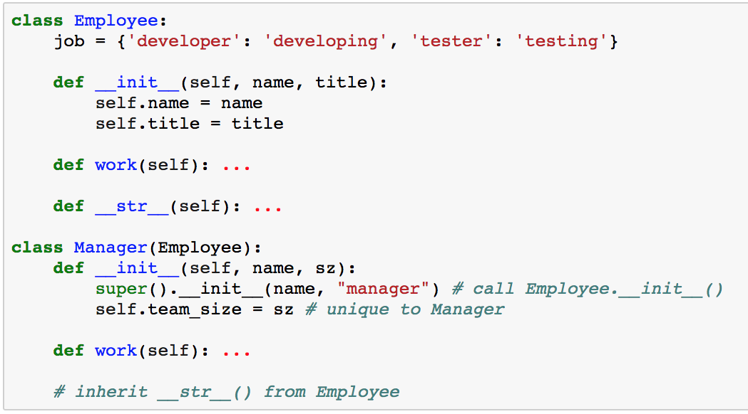
Overriding Superclass’ __init__()
Manager.__init__() overrides Employee.__init__() so Employee’s instance attributes are not defined in Manager unless we call super().__init__() explicitly

Slide 35
Single Inheritance Summary
The subclass inherits all methods from the superclass
Super class instance attributes may be available, depending on if __init__() is redefined in the subclass or if super().__init__() is called
The subclass may add new class attributes, instance attributes, and methods
Any method, including __init__(), can be overridden by the subclass
If you override __init__() then you may want to call super().__init__() to create and initialize the superclass’s instance variables in the subclass
Or, define instance attributes needed by the subclass but that may defeat the advantages of using inheritance.

Slide 36
When to use OOP?
Python supports both Procedural and Object Oriented Programming
When to use each approach?
Objects have both properties and behaviors
If only behaviors then a function may be be simpler
If only properties, then a Python data structure may be better
If both, then a class is a good solution
How many instances of an object do you need?
Only one? A class may be overkill
Many? Class is a great solution
If inheritance is natural, then classes are a great solution
Use classes anytime they improve readability!

Slide 37
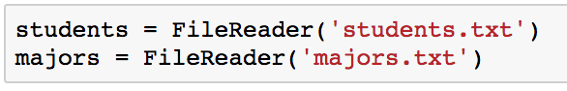
When to use OOP?
Task: write a program to summarize a file with the number of lines, words, and characters
Should we define a class?
Might we need to represent multiple files?
Class instances make that trivial
Encapsulation makes the code easier to understand, maintain, and reuse

Slide 38
Object Oriented Design
You’re working on a new problem
How to identify objects to represent as objects?
How to identify the attributes and methods?

Slide 39
CRC Cards
Class: name of the class
Responsibilities: what must the class do?
Collaborators: other classes that will help
Class: Class Name Responsibilities | Collaborators
Map to attributes or methods
Map to other classes

Slide 40
CRC Cards Example
Create CRC cards for the Rock/Paper/Scissors game
Identify a class (frequently nouns in the domain)
Add responsibilities (verbs associated with classes)
For each responsibility, identify collaborators
Create new classes for new collaborators
Iterate as you detect missing classes or collaborators
Class: Game Responsibilities | Collaborators
Get human move | Player
Get computer move | Player
Identify winner
Class: Player Responsibilities | Collaborators
Choose move

Slide 41
Microsoft Design Guidelines
Separation of Concerns
Single Responsibility Principle
Principle of Least Knowledge
Don’t Repeat Yourself (DRY)
Minimize Upfront Design (KISS)
Minimize overlap between components
A class/method/function should do one thing well
Minimize what others need to know about your internals (don’t know and don’t care)
Don’t duplicate functionality in multiple places
Keep it simple and elegant
https://msdn.microsoft.com/en-us/library/ee658124.aspx

Slide 42
Design Summary
Good design is a thing of beauty
There are guidelines and heuristics but no cookbook
Good design is a learned through study, experience and review

Slide 43


Slide 44

Things don’t always go as planned…
These are all examples of Python exceptions

Slide 45
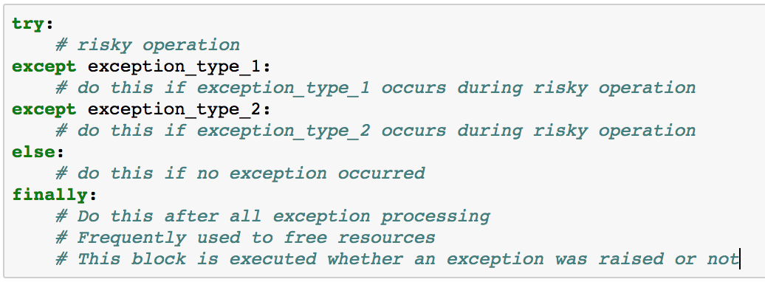
Exceptions: anticipate problems

Slide 46
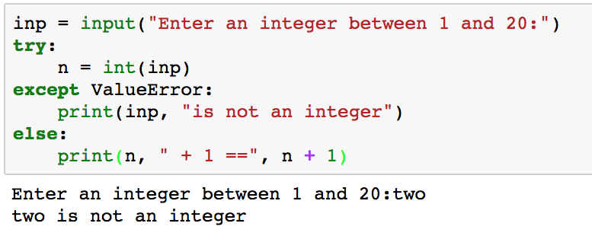
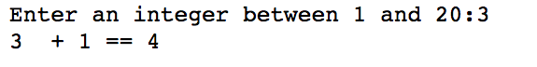
Anticipate problems with user input

Slide 47
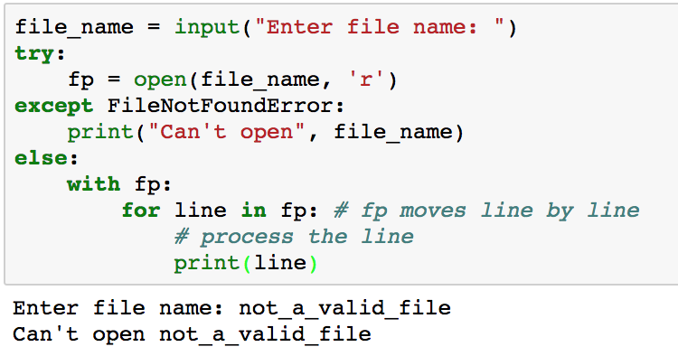
Anticipate problems opening a file

Slide 48
Common Python Built In Exceptions
Exception Name | Description
Exception | Base class for all exceptions
ValueError | Raised when an invalid value is seen
FileNotFoundError | Raised when attempting to open a non-existent file
StopIteration | Used by generators to stop iteration
SystemExit | Raised by system.exit()
ArithmeticError | Base class for exceptions during numeric calculation
ZeroDivisionError | Raised on division by zero
AssertionError | Raised when an Assert statement fails
AttributeError | Raised when accessing a non-existent attribute
KeyboardInterrupt | Raised when user raises an interrupt, e.g. Ctrl-C
NameError | Raised when an unknown name is accessed
SyntaxError | Raised when Python encounters a syntax error
Your Exception | You can define and raise your own exceptions

Slide 49
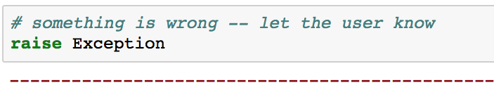
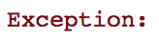
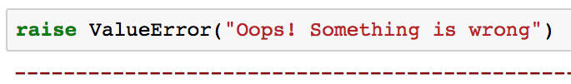
Raising exceptions
Raise an exception in your code to identify error conditions
But which exception?
Use an existing Python exception or build your own with inheritance

Slide 50
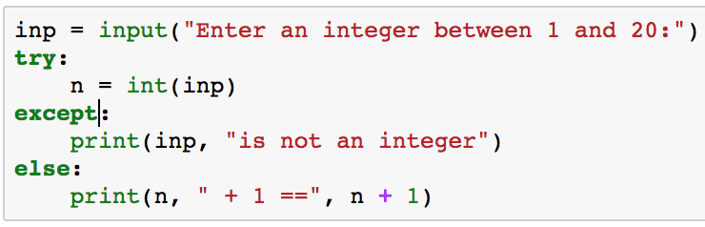
Unqualified except
Avoid unqualified except, e.g.
Unlike other languages with exceptions, Python uses exceptions for many situations
This block is invoked for ANY exception, not just the ones you expect

Slide 51

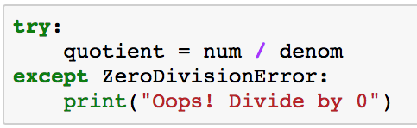
What was the name of that exception?
Recall, when it doubt, try it out…
What’s the name of the exception for divide by 0?
Here’s the name of the exception to use in the try/except block

Slide 52
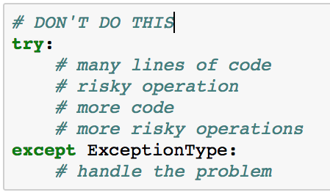
Keep try blocks small
Keep try blocks as small as possible to isolate issues
Exceptions can occur for many reasons
Minimize the lines between the event that may raise an exception and the exception handler
Which code caused the exception to be raised?

Slide 53
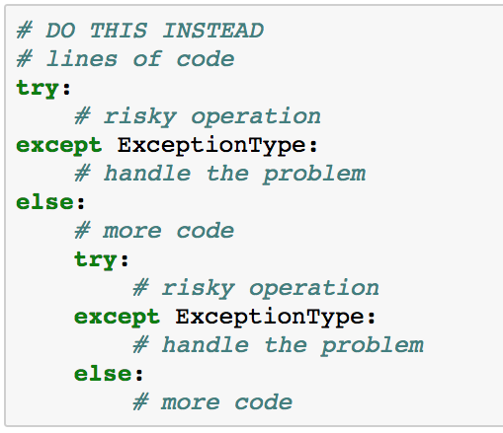
Keep try blocks small
Now you can isolate the reason that the exception was raised

Slide 54
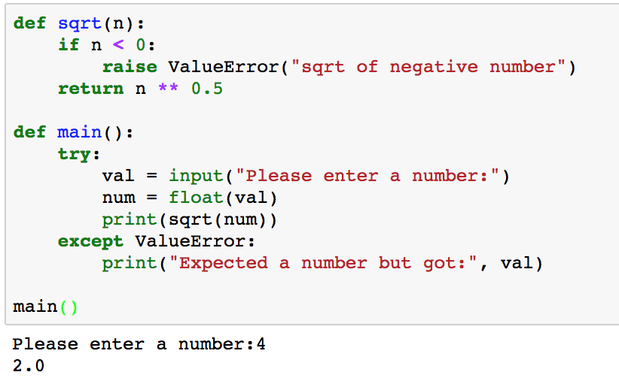
What could possibly go wrong?
Warn users about negative values
Warn users about invalid input values
So far, so good…

Slide 55
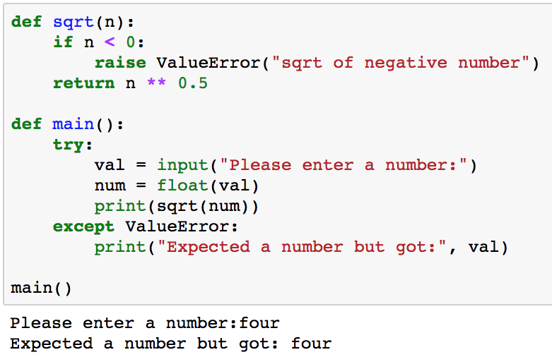
What could possibly go wrong?
Try an invalid input value…
So far so good…

Slide 56
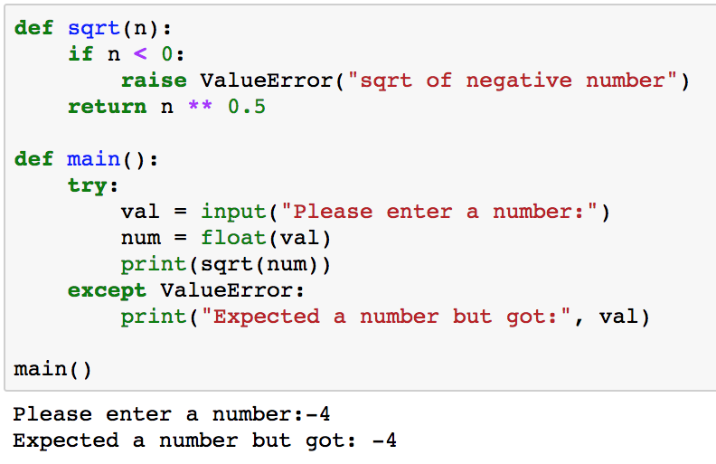
What could possibly go wrong?
Try a negative number…
WHAT??? -4 is a number!!!

Slide 57
What could possibly go wrong?
float(val) raises ValueError on error but so does sqrt(n) . Main() doesn’t distinguish between the two cases
Try a negative number…
WHAT??? -4 is a number!!!

Slide 58
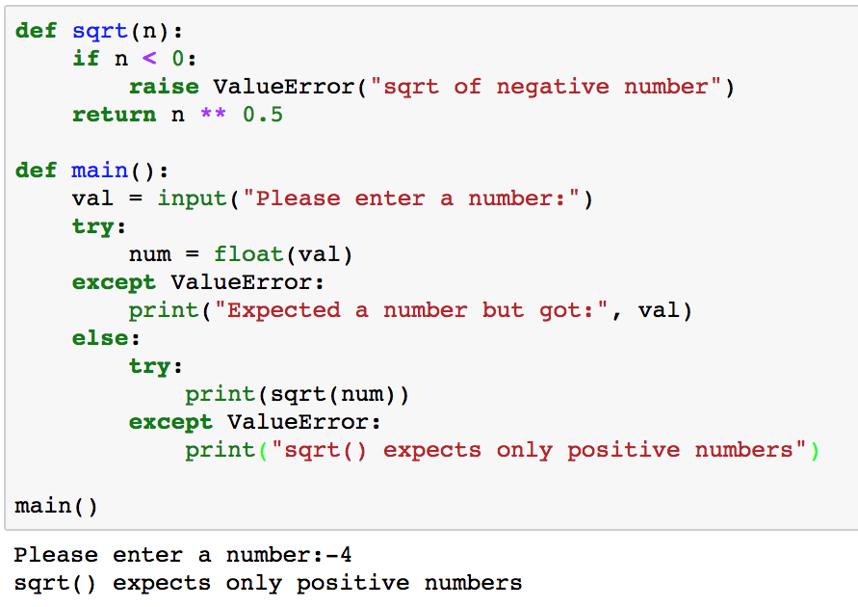
What could possibly go wrong?
Limit try/except blocks to just the risky code

Slide 59
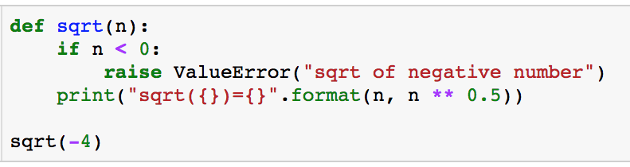
Program flow with exceptions
Raising an exception pops the runtime call stack, returning from functions, until the exception is caught:
in a try/except block somewhere in the call stack
by the Python interpreter (REPL)
Exception caught by the Python interpreter

Slide 60
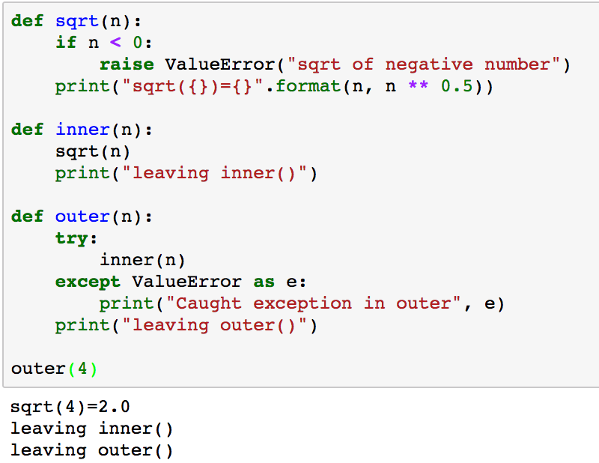
Program flow with no exceptions
REPL calls outer(4)
outer(4) calls inner(4)
inner(4) calls sqrt(4)
sqrt(4) prints message, returns to inner()
Inner prints message, returns to outer()
outer() returns to Python REPL

Slide 61
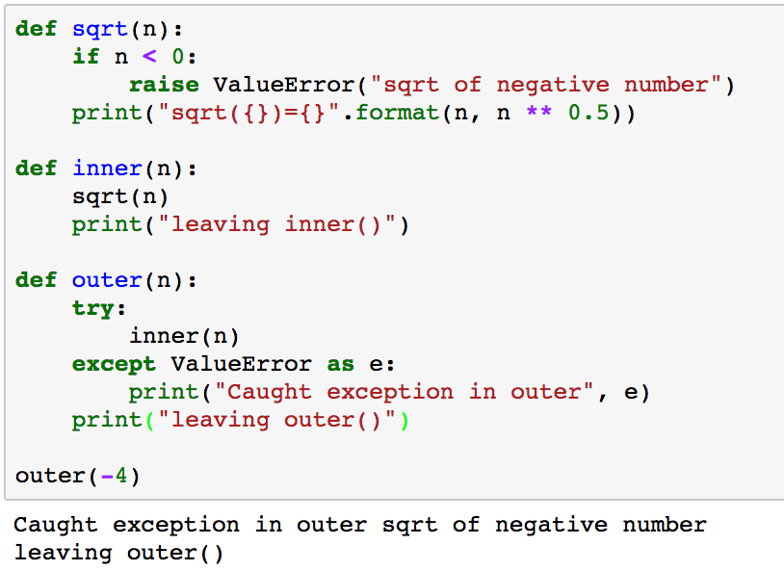
Program flow with exceptions
REPL calls outer(-4)
outer(-4) calls inner(-4)
inner(-4) calls sqrt(-4)
sqrt(-4) raises a ValueError Exception
Inner(-4) doesn’t catch the exception so execution flows to outer(-4) where exception is caught

Slide 62
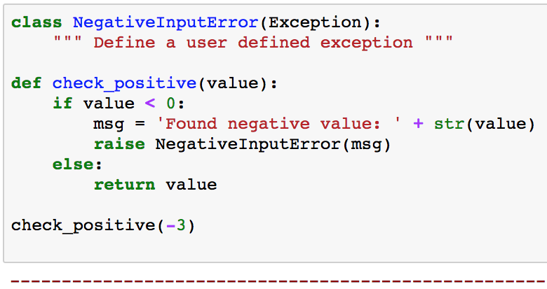
Define your own exceptions
NegativeInputError can be used anywhere you use exceptions

Slide 63
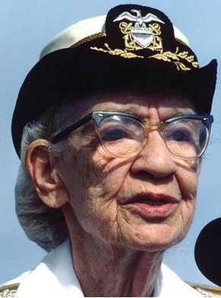
LBYL vs EAFP Strategies
LBYL: Look Before You Leap (C++, Java)
Check carefully before attempting something risky to avoid exceptions
EAFP: Easier to Ask Forgiveness than Permission¹ (Python)
Write maintainable code that assumes everything is okay
Handle the situations where something goes wrong
Leads to more readable and maintainable code
¹Attributed to Admiral Grace Hopper, a computing pioneer

Slide 64
LBYL vs EAFP
LBYL: (Java, C++)
double
safe_div(float n, float d) {
if (d == 0) {
cerr << “divide by 0”;
return 0;
} else {
return n/d;
}
}
EAFP: (Python)
def safe_div(n, d):
try:
return n/d
except ZeroDivisionError:
print(“divide by 0”)

Slide 65

Questions?

